Slide 1


Trends in Surrogate/Meta-Modeling
and Multi-fidelity
Ramana V. Grandhi
Distinguished Professor
Department of Mechanical and Materials Engineering
11 June 2015

Slide 2
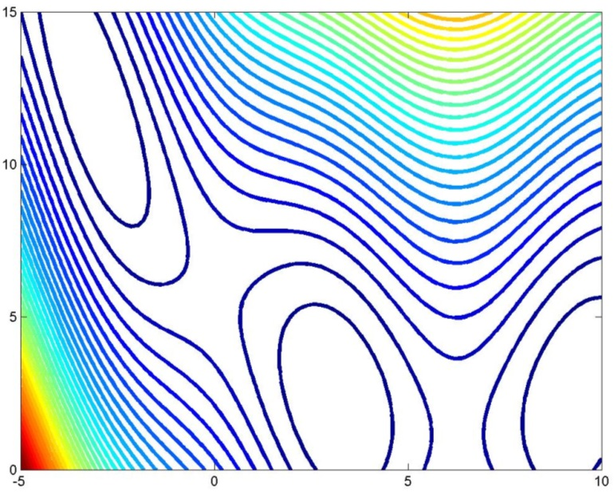
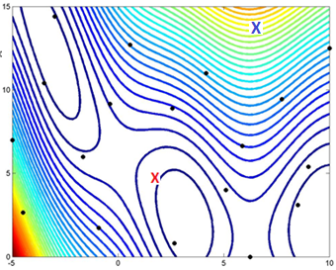
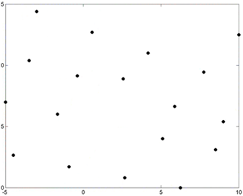
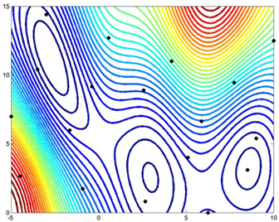
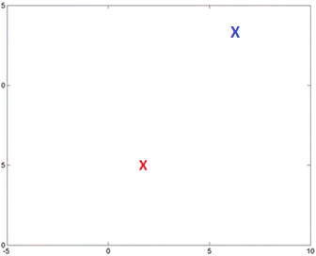
Surrogate Modeling – What Is It?
“True” Function
Updated Surrogate Model
Available Data
Surrogate Model
New Data via Update Algorithm

Slide 3
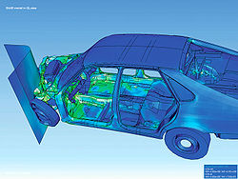
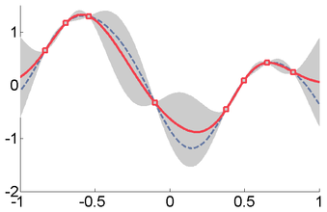


Surrogate Modeling – Why Do We Need It?
High-Fidelity Simulation
Surrogate of High-Fidelity
$$≈$$
True
Surrogate
$$Y\left(x\right)=β_{0}+β_{1}x+β_{2}x^{2}+β_{3}x^{3}$$
High Computational Cost
Low Computational Cost

Slide 4
Surrogate Modeling – Techniques
Model Building Techniques (Mathematical Model Generation)
  Polynomial Point Approximation
  Polynomial Regression
  Radial Basis Function
  Kriging
  Support Vector Machine
  Neural Network
  Bootstrapping
  Cross-Validation
  Sub-Structure FEM
Design Space Mapping/Exploration Techniques (Intelligent Generate New Data Points)
  Latin Hypercube/Monte Carlo
  Space Filling Algorithms
  Prediction-based
  Error-based
  Likelihood Approaches
  Max/Min Search Approaches
  Adaptively Train Surrogate
  Clustering/Mapping Algorithm
Sensitivity Information
  Increase Surrogate Accuracy
  Intelligent Search Algorithms

Slide 5
Surrogate Modeling – Techniques
Model Building Techniques (Mathematical Model Generation)
  Polynomial Point Approximation
  Polynomial Regression
  Radial Basis Function
  Kriging
  Support Vector Machine
  Neural Network
  Bootstrapping
  Cross-Validation
  Sub-Structure FEM
Design Space Mapping/Exploration Techniques (Intelligent Generate New Data Points)
  Latin Hypercube/Monte Carlo
  Space Filling Algorithms
  Prediction-based
  Error-based
  Likelihood Approaches
  Max/Min Search Approaches
  Adaptively Train Surrogate
  Clustering/Mapping Algorithm
1,1
1
1,1
3
1
1
1
1
2
1
1,2
1,1
Sensitivity Information
  Increase Surrogate Accuracy
  Intelligent Search Algorithms
1,3
Utilize Existing Technique
10
Novel Technique Development
14

Slide 6
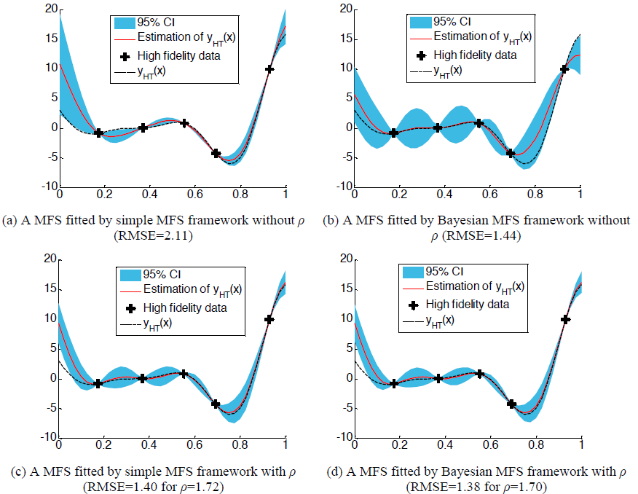
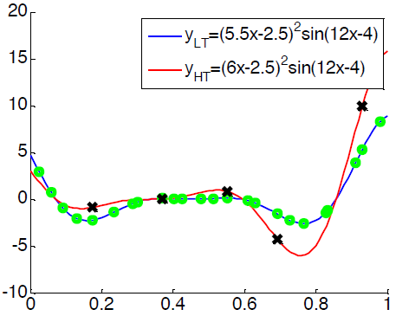
Examples - Model Building Techniques
1056 – Haftka, Kim, et al
“Experience with Several Bayesian Gaussian process Multi-Fidelity Surrogates”
Hartmann 6 test function
  Multi-Fidelity Analysis
  Kriging
  Define discrepancy Function (Difference in Low and High Fidelity)

Slide 7
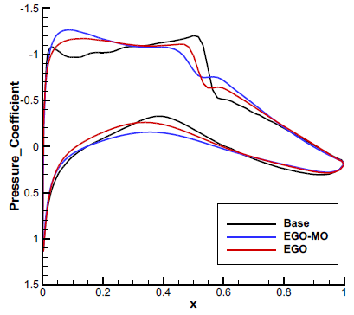
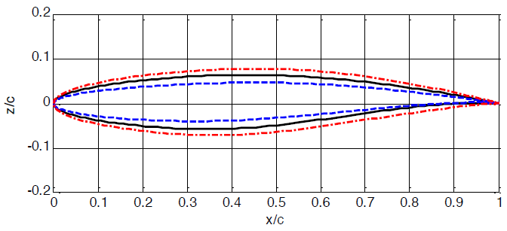
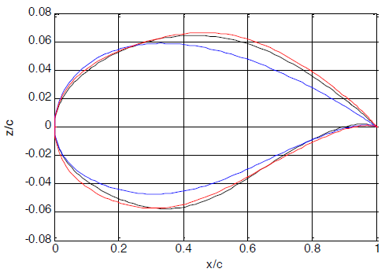
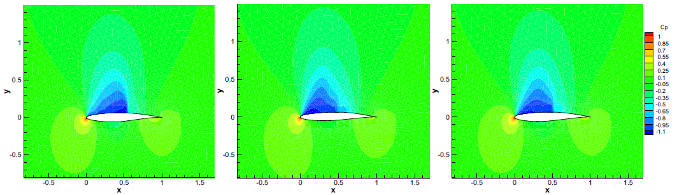
Examples - Model Building Techniques
1119 – Zhiwei Feng et al
“Efficient Aerodynamic Optimization Using a Multiobjective Optimization Based Framework to Balance the Exploration and Exploitation”
Airfoil shape optimization
  Kriging
  Objective Function Surrogate

Slide 8
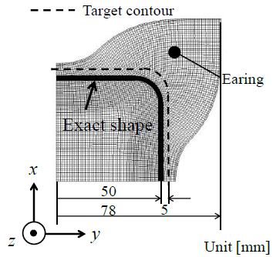
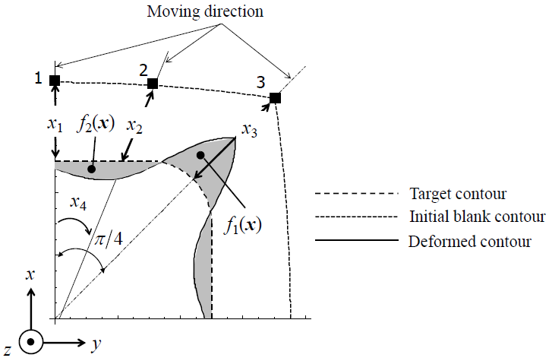
Examples - Model Building Techniques
1375 – Satoshi Kitayama et al
“Simultaneous optimization of initial blank shape and blank holder force trajectory for square cup deep drawing using sequential approximate optimization”
Optimization of initial blank shape for punch
  Radial Basis Function
  Objective Function Surrogate

Slide 9
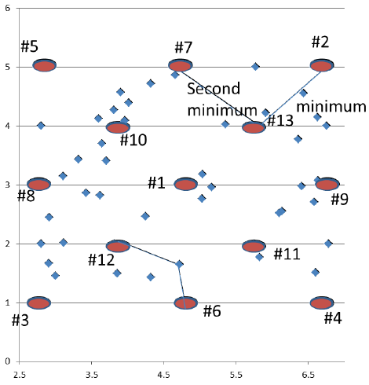
Examples - Design Space Mapping/Exploration Techniques
1239 – Masao Arakawa
“Zooming in Surrogate Optimization Using Convolute RBF”
SBO of numerical pressure vessel
  Zooming Technique
  Narrow/Divide Design Space
  Build multiple RBFs over each subspace

Slide 10
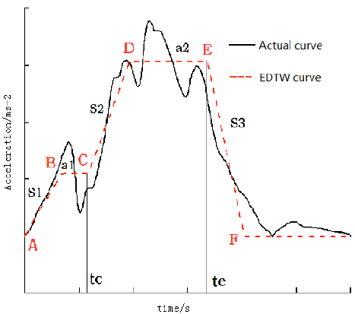
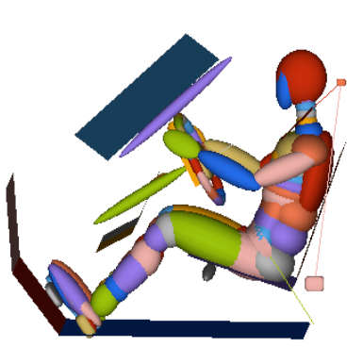
Examples - Sensitivity Information
1114 – Weigang Zhang et al
“Multi-Parameter Optimization Study on the Crashworthiness Design of a Vehicle by Using Global Sensitivity Analysis and Dynamic Metamodel”
Crashworthiness Design of Vehicle
  Kriging
  Global Sensitivity Analysis - locate points

Slide 11
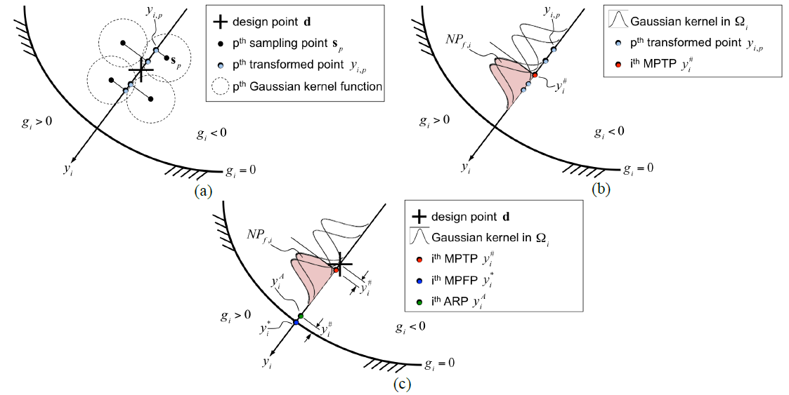
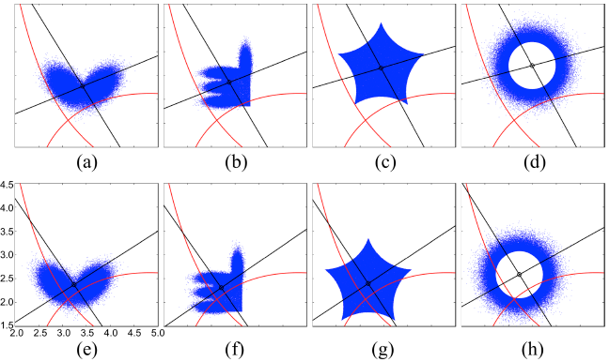
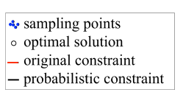
Examples - Sensitivity Information
1211 – Po Ting Lin
“Utilization of Gaussian Kernel Reliability Analyses in the Gradient-based Transformed Space for Design Optimization with Arbitrarily Distributed Design Uncertainties”
RBDO of numerical test cases
  Sensitivity Analysis - accuracy
  Taylor Surrogate

Slide 12
Surrogate Modeling – Where Efforts Should be Focused
Model Building Techniques (Mathematical Model Generation)
  Polynomial Point Approximation
  Polynomial Regression
  Radial Basis Function
  Kriging
  Support Vector Machine
  Neural Network
  Bootstrapping
  Cross-Validation
  Sub-Structure FEM
Design Space Mapping/Exploration Techniques (Intelligent Generate New Data Points)
  Latin Hypercube/Monte Carlo
  Space Filling Algorithms
  Prediction-based
  Error-based
  Likelihood Approaches
  Max/Min Search Approaches
  Adaptively Train Surrogate
  Clustering/Mapping Algorithm
Sensitivity Information
  Increase Surrogate Accuracy
  Intelligent Search Algorithms

Slide 13
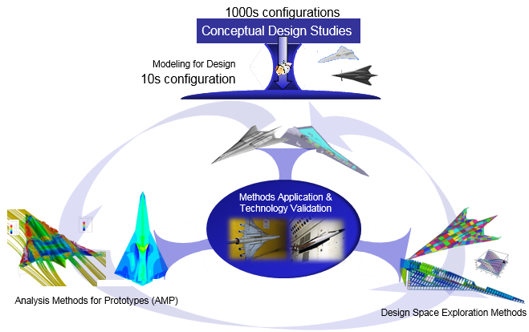
Multi-Fidelity – What Is It?

Slide 14
Multi-Fidelity – What Is It?
Conceptual Design Phase – Analytical Surrogates, Historical Data, Little to no Physics

Slide 15
Multi-Fidelity – What Is It?
Preliminary Design Phase – Low-Order Physics, Coarse Grid, Some Physics Ignored

Slide 16
Multi-Fidelity – What Is It?
Detailed Design Phase – Full Physics, Converged Grid, All Physics Included

Slide 17
Multi-Fidelity – What Is It?
Multi-Fidelity – Adaptively “Dial” between Fidelity Levels (Amount of Physics Incorporated in Simulation Model)

Slide 18
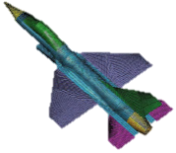
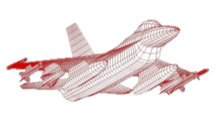
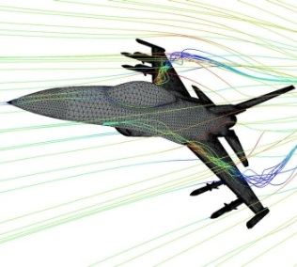
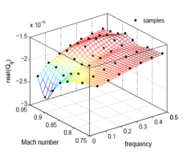
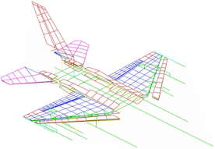
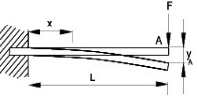
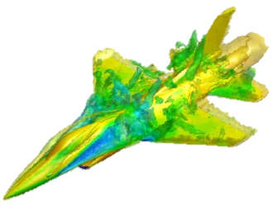

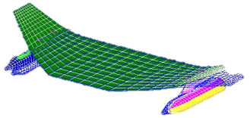
Multi-Fidelity – What Is It?
Practical design & system optimization
  Adaptive to available resources/time
  Seamless movement between levels of fidelity when needed and as needed (“dialable” fidelity)
  Pull more physics/fidelity into design loop at the appropriate time & for most benefit
A response may be obtained using models of different fidelity
Low Order, Analytical Expression, Surrogates, Historical Database
Medium Fidelity,
Physics-based, Reduced Order
High Fidelity
Full Physics Models

Slide 19
Multi-Fidelity – What Is It?
Practical design & system optimization
  Adaptive to available resources/time
  Seamless movement between levels of fidelity when needed and as needed (“dialable” fidelity)
  Pull more physics/fidelity into design loop at the appropriate time & for most benefit
A response may be obtained using models of different fidelity
Increasing fidelity - increasing computational cost
Low Order, Analytical Expression, Surrogates, Historical Database
Medium Fidelity,
Physics-based, Reduced Order
High Fidelity
Full Physics Models

Slide 20
Multi-Fidelity – What Is It?
Practical design & system optimization
  Adaptive to available resources/time
  Seamless movement between levels of fidelity when needed and as needed (“dialable” fidelity)
  Pull more physics/fidelity into design loop at the appropriate time & for most benefit
A response may be obtained using models of different fidelity
Increasing fidelity - increasing computational cost
Low Order, Analytical Expression, Surrogates, Historical Database
Medium Fidelity,
Physics-based, Reduced Order
High Fidelity
Full Physics Models
Optimization process should shift between fidelities as needed

Slide 21
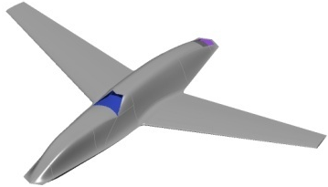
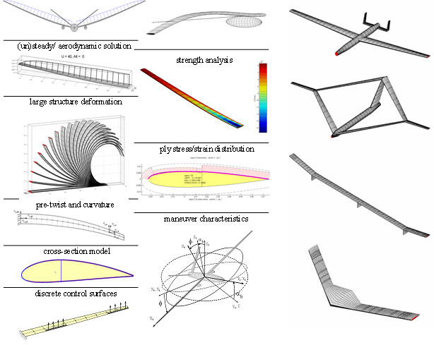
Multi-Fidelity – Why Do We Need It?
Conceptual
Preliminary
Detailed
Broad design space exploration
Global search techniques
Many concept configurations
Low fidelity analyses and low fidelity realization of parts
Available technology assessment
Culminates in down-selection to one or few concepts to pursue
Prototype Concept
Design freedom & effect on final performance

Slide 22
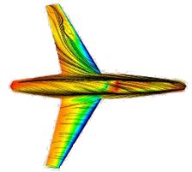
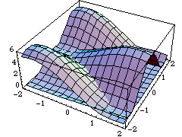
Multi-Fidelity – Why Do We Need It?
Conceptual
Preliminary
Detailed
Broad design space exploration
Global search techniques
Many concept configurations
Low fidelity analyses and low fidelity realization of parts
Available technology assessment
Culminates in down-selection to one or few concepts to pursue
Study of one or few prototype configurations
Higher fidelity discipline analyses
Component-level and subsystem optimization
Discipline trade space exploration
Prototype Concept
Feasible Design
Design freedom & effect on final performance

Slide 23
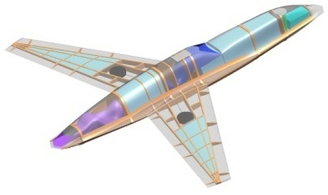
Multi-Fidelity – Why Do We Need It?
Conceptual
Preliminary
Detailed
Broad design space exploration
Global search techniques
Many concept configurations
Low fidelity analyses and low fidelity realization of parts
Available technology assessment
Culminates in down-selection to one or few concepts to pursue
Design “locked in”
Optimization of manufacturing details, fasteners, etc
Technical drawings
Tooling design and machining
Acquisition details
Secondary subsystem design
Study of one or few prototype configurations
Higher fidelity discipline analyses
Component-level and subsystem optimization
Discipline trade space exploration
Prototype Concept
Feasible Design
Design freedom & effect on final performance

Slide 24
Multi-Fidelity – Why Do We Need It?
Conceptual
Preliminary
Detailed
Broad design space exploration
Global search techniques
Many concept configurations
Low fidelity analyses and low fidelity realization of parts
Available technology assessment
Culminates in down-selection to one or few concepts to pursue
Design “locked in”
Optimization of manufacturing details, fasteners, etc
Technical drawings
Tooling design and machining
Acquisition details
Secondary subsystem design
Study of one or few prototype configurations
Higher fidelity discipline analyses
Component-level and subsystem optimization
Discipline trade space exploration
Prototype Concept
Feasible Design
Different optimization techniques/methods utilized throughout
Design freedom & effect on final performance

Slide 25
Multi-Fidelity – Why Do We Need It?
Blending of Conceptual/Preliminary Design
  Increasing fidelity level & coupling earlier in design process
    Utilize maximum fidelity based on computational resources
  Maintain configuration variability for best design space exploration (best design freedom)
Conceptual/Preliminary
Conceptual
Preliminary
Detailed
Detailed
Design freedom & effect on final performance

Slide 26
Multi-Fidelity – Why Do We Need It?
Blending of Conceptual/Preliminary Design
  Increasing fidelity level & coupling earlier in design process
    Utilize maximum fidelity based on computational resources
  Maintain configuration variability for best design space exploration (best design freedom)
Conceptual/Preliminary
Conceptual
Preliminary
Detailed
Detailed
Design freedom & effect on final performance

Slide 27
Multi-Fidelity – Why Do We Need It?
Blending of Conceptual/Preliminary Design
  Increasing fidelity level & coupling earlier in design process
    Utilize maximum fidelity based on computational resources
  Maintain configuration variability for best design space exploration (best design freedom)
Conceptual/Preliminary
Conceptual
Preliminary
Detailed
Detailed
Design freedom & effect on final performance

Slide 28

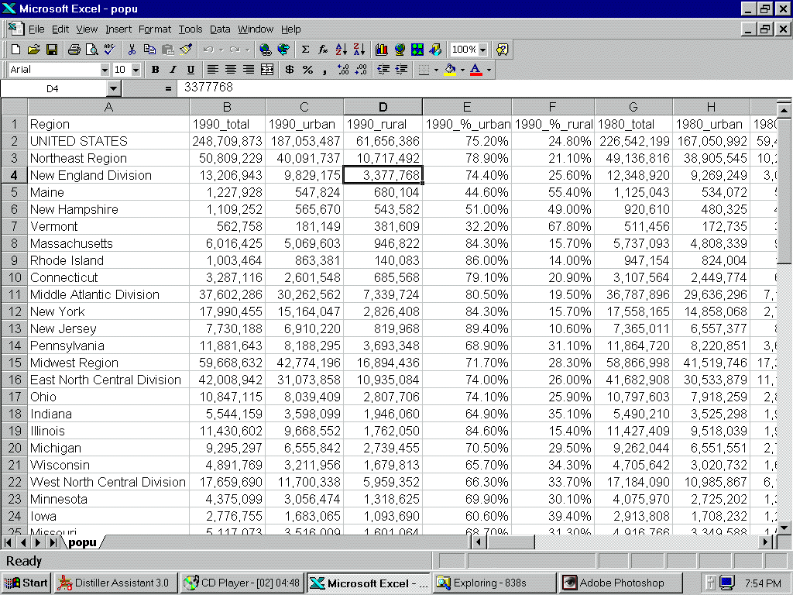
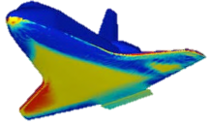
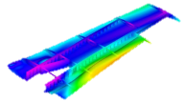
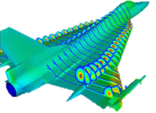

Multi-Fidelity – Why Do We Need It?
Blending of Conceptual/Preliminary Design
  Increasing fidelity level & coupling earlier in design process
    Utilize maximum fidelity based on computational resources
  Maintain configuration variability for best design space exploration (best design freedom)
Conceptual/Preliminary
Conceptual
Preliminary
Detailed
Detailed
Design freedom & effect on final performance

Slide 29
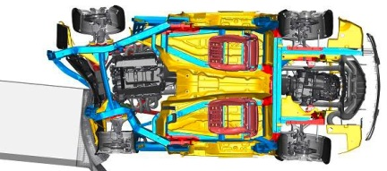
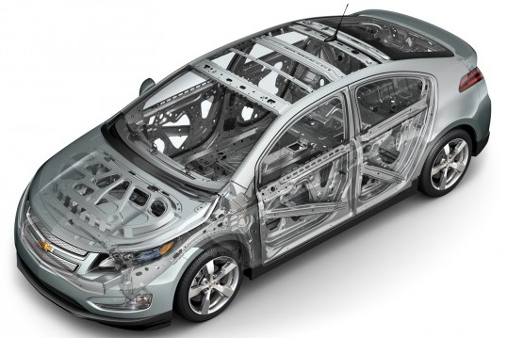
Multi-Fidelity – What Should It Look Like?
Computational Model
3 Major Areas in Developing Multi-Fidelity Constructs
  HOW to switch/combine fidelities
  WHEN to switch/combine fidelities
  WHICH fidelities to switch/combine
Goals
  Develop methods for answering these HOW, WHEN, WHERE questions
  Mathematically rigorous
  Pervasive to broad range of disciplines and designs
Applicability
  Automotive Design
    CFD, Systems, Thermoelasticity, etc.
  Aerospace Design, Industrial Design, etc.

Slide 30
Multi-Fidelity – Techniques
HOW
  Surrogate Modeling
  Low-Fidelity Response Correction
  Low-Fidelity Physics Correction
  Use LF Optimization with HF Convergence Criteria
  Design Variable Mapping
WHEN
  Uncertainty Driven Metrics
  Validation Driven Metrics
  Computation Driven Metrics
  Intelligent Uncertainty Handling Networks (Bayesian)
WHICH
  Model Management Techniques
  Uncertainty Quantification (Evidence Theory)
  Model Accuracy Metrics
  Expert Opinion/Experience

Slide 31
Multi-Fidelity – Techniques
HOW
  Surrogate Modeling
  Low-Fidelity Response Correction
  Low-Fidelity Physics Correction
  Use LF Optimization with HF Convergence Criteria
  Design Variable Mapping
WHEN
  Uncertainty Driven Metrics
  Validation Driven Metrics
  Computation Driven Metrics
  Intelligent Uncertainty Handling Networks (Bayesian)
WHICH
  Model Management Techniques
  Uncertainty Quantification (Evidence Theory)
  Model Accuracy Metrics
  Expert Opinion/Experience
1
1
1
Utilize Existing Technique
1
Novel Technique Development
2

Slide 32
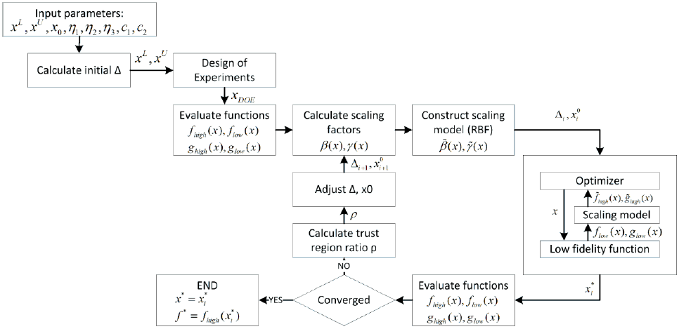
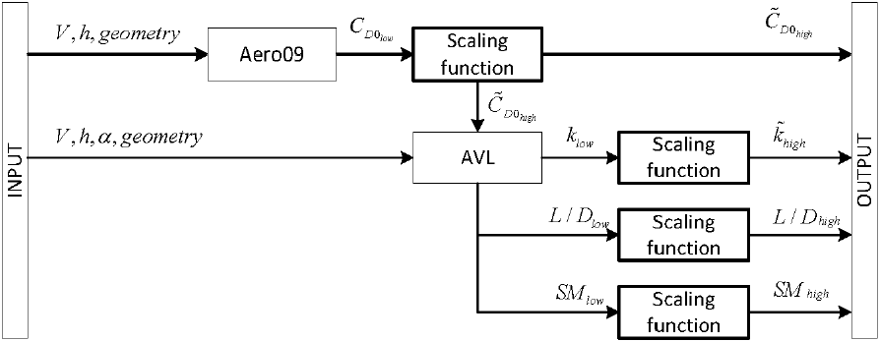
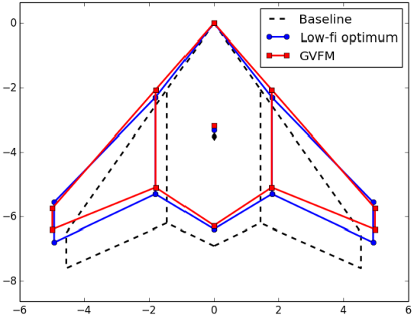
Multi-Fidelity – Low-Fidelity Response Correction
1052 – Maxim Tyan et al
“A Flying Wing UCAV Design Optimization Using Global Variable Fidelity Modeling”
MDO Design of UAV/UCAV
  Variable Fidelity Optimization
  Global Variable Fidelity Modeling
  Low-Fidelity Correction

Slide 33
Multi-Fidelity – Low-Fidelity Correction
1056 – Haftka, Kim, et al
“Experience with Several Bayesian Gaussian process Multi-Fidelity Surrogates”
Hartmann 6 test function
  Multi-Fidelity Analysis
  Low-Fidelity Correction via Discrepancy Function
  Use High-Fidelity information to tune Low-Fidelity Model

Slide 34
Multi-Fidelity – Where Efforts Should be Focused
HOW
  Surrogate Modeling
  Low-Fidelity Response Correction
  Low-Fidelity Physics Correction
  Use LF Optimization with HF Convergence Criteria
  Design Variable Mapping
WHEN
  Uncertainty Driven Metrics
  Validation Driven Metrics
  Computation Driven Metrics
  Intelligent Uncertainty Handling Networks (Bayesian)
WHICH
  Model Management Techniques
  Uncertainty Quantification (Evidence Theory)
  Model Accuracy Metrics
  Expert Opinion/Experience

Slide 35
Conclusions
Surrogate/Meta-Modeling
  Mature Techniques
  Well addressed in Literature
  Current
    Utilize Sensitivities
    Intelligent Design Space Exploration
  Future
    Utilize Sensitivities
    Intelligent Design Space Exploration
Multi-Fidelity
  Infancy Stages
  Driving Need for New Techniques
  Current
    Use of surrogates to correct low-fidelity
  Future
    Techniques to address 3 major areas

Slide 36
Thank You!
Questions?

